Slide 1


Design and Implementation of Custom Unix Shell
Mentorship: Manikanta
Team: Riya Gupta, Vamsi G D N, Naisha Dekate, Arpan Tiwari

Slide 2
Project Vision: A Smarter Shell for Modern Engineers
Traditional shell environments often fall short in providing real-time system visibility and proactive user assistance. Our project addresses these limitations by developing a custom C implementation of the POSIX REPL architecture, designed to enhance the engineering workflow.
The Problem: Reactive Shells
The Solution: Custom POSIX REPL
Existing shells are largely reactive, offering limited real-time insight into dynamic system changes. This creates a gap in operational awareness for critical tasks.
We've engineered a bespoke C-based shell that bridges high-level user experience with low-level kernel system calls, providing a more intelligent and responsive environment.
Core Goal: UX Meets Kernel
Philosophy: Modular Design
Our primary objective is to seamlessly integrate intuitive user interfaces with the raw power and data of kernel-level operations, optimizing both control and visibility.
Every feature is developed as a standalone plugin (e.g., cmd_*.c), ensuring maximum scalability, maintainability, and flexibility for future enhancements.

Slide 3
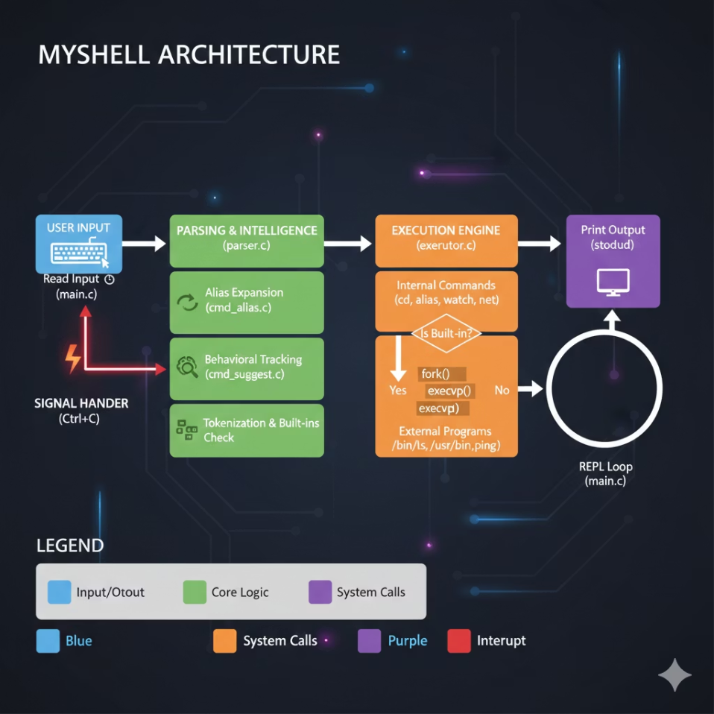

Architecture & System Flow: The Shell's Inner Workings
Our shell's architecture is meticulously designed for robustness and efficiency, handling input, parsing, and execution with advanced techniques to ensure system stability and performance.
01
02
Input Acquisition
Intelligent Parsing
Leveraging custom sigaction-based signal trapping, our shell is fortified against sub-process failures, ensuring uninterrupted operation even in volatile environments.
A sophisticated, multi-stage parser dissects commands, performing critical functions like Alias Expansion, Behavioral Analysis, and precise Tokenization, translating user input into executable logic.
03
Execution Engine
The core of our shell's power lies in its efficient process management, utilizing fork() and execvp() to spawn and control child processes effectively, ensuring commands are executed reliably.

Slide 4
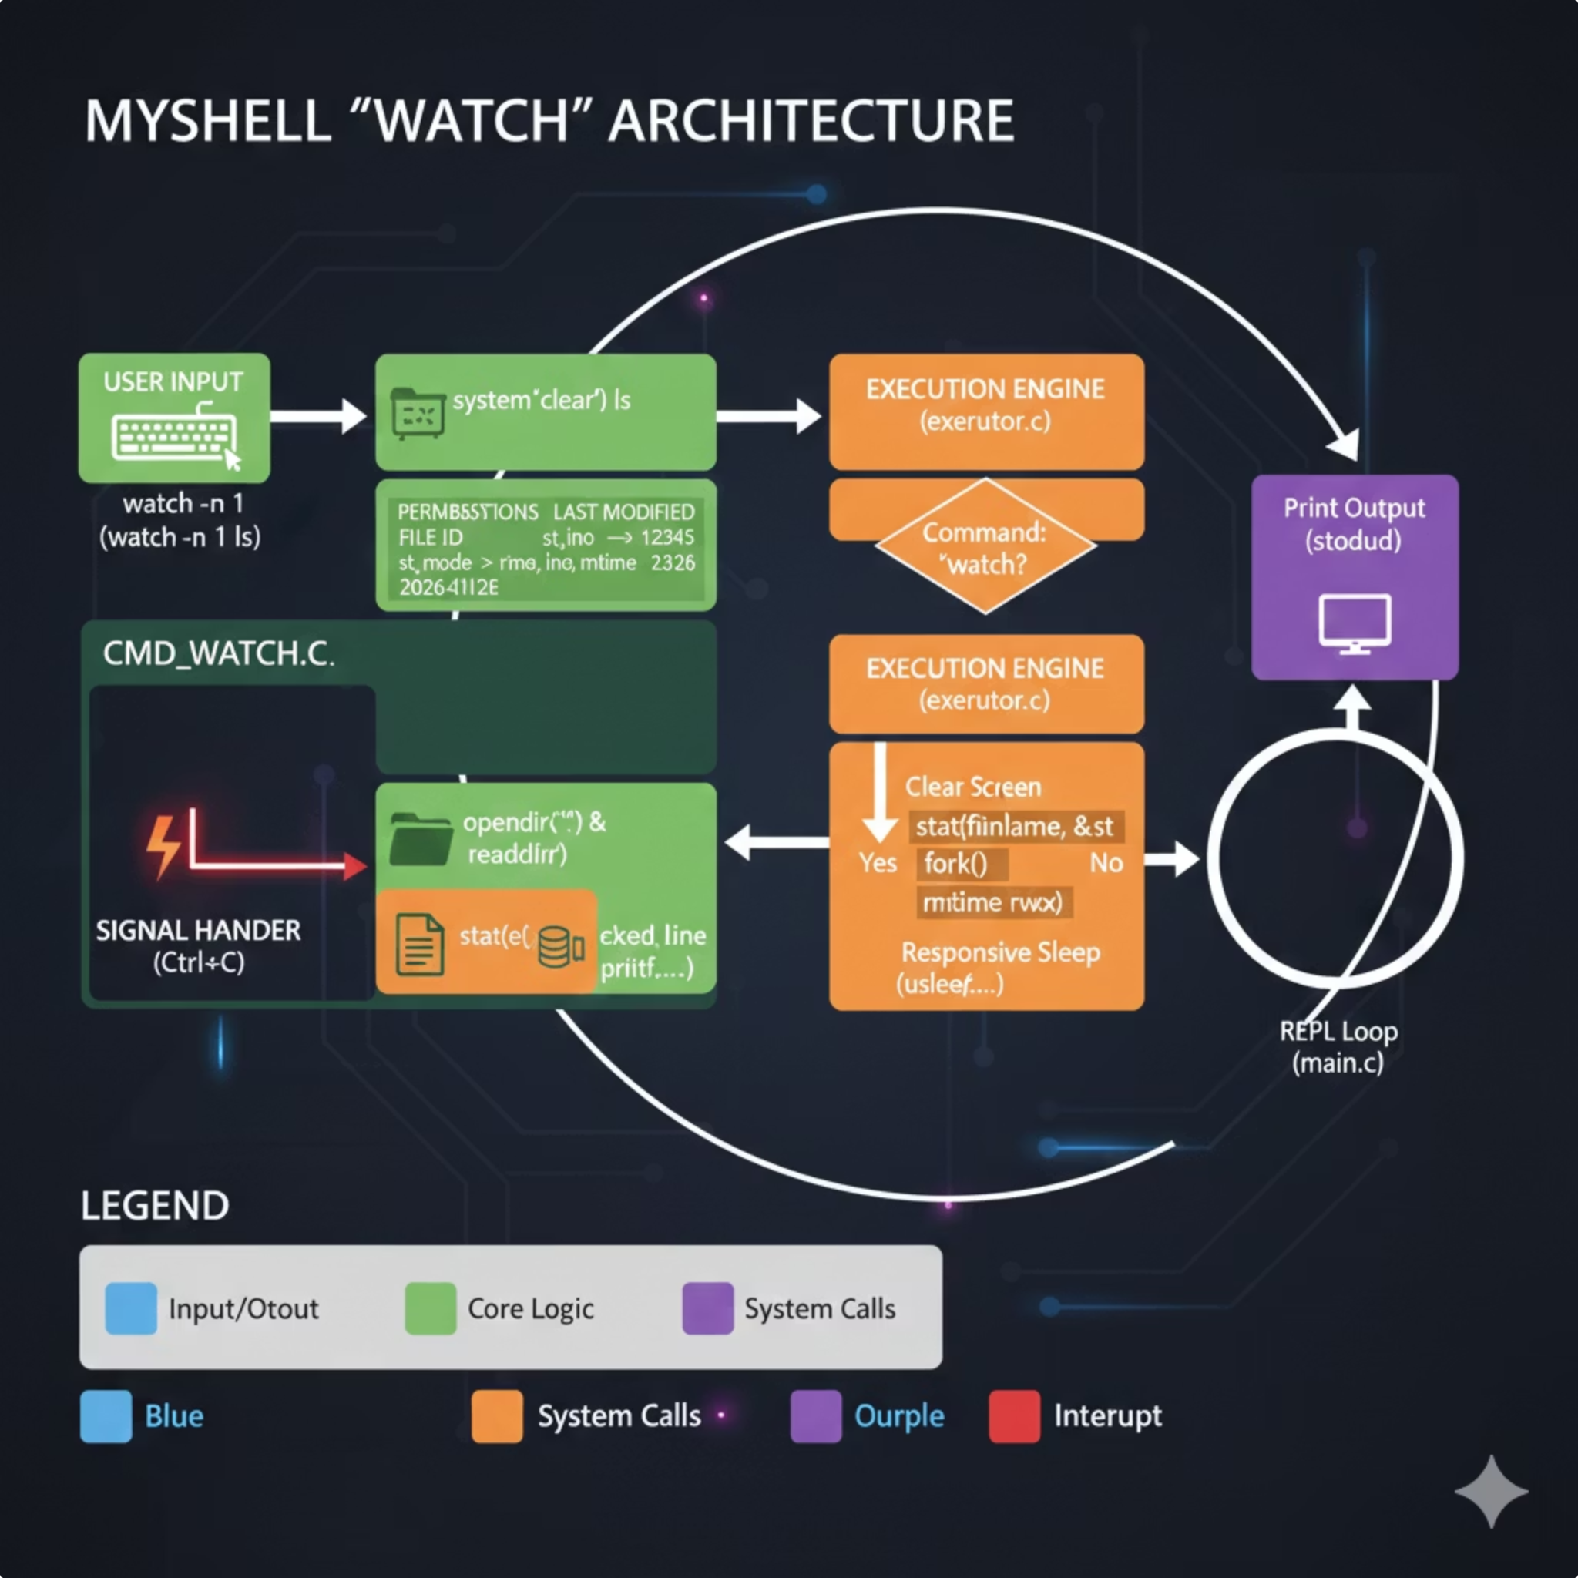
Advanced Process Monitoring: Watch 2.0
Beyond the capabilities of a standard ls command, our custom watch utility provides deep, real-time insights by fetching live kernel metadata. This offers unparalleled visibility into system changes.
Unique Inodes
Every file within the system is tracked by its immutable, permanent system File ID (inode), ensuring precise identification and monitoring regardless of path changes.
Granular Permissions
Observe the live rwxr-xr-x strings for each file individually, providing immediate and accurate visibility into access controls and potential security vulnerabilities.
Timestamp Precision
Monitor exact modification times with nanosecond precision via stat() calls, crucial for debugging race conditions and understanding file system dynamics.

Slide 5
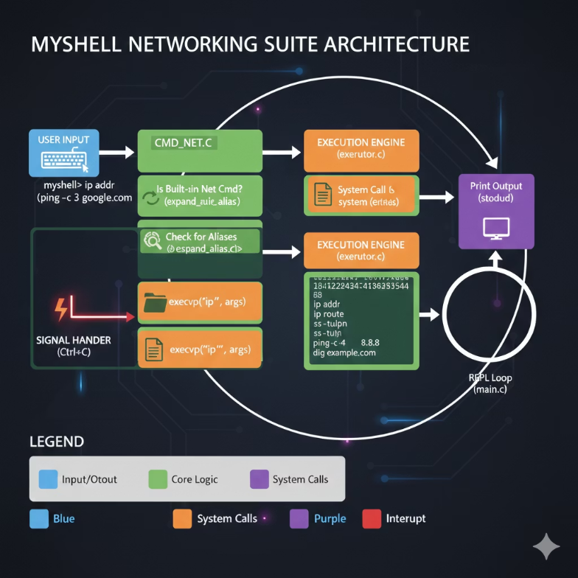




Professional Networking Suite: Integrated Troubleshooting
Our shell integrates a comprehensive suite of networking tools, allowing engineers to diagnose and manage network connectivity directly from the custom environment, eliminating the need to switch contexts.
Integrated Toolkit
Native execution capabilities for both modern iproute2 and traditional troubleshooting utilities, streamlining network diagnostics.
Modern Management
Full support for ip addr, ip route, and ss for high-speed analysis of active sockets and routing tables.
Diagnostic Power
Built-in integration for essential tools like ping, traceroute, mtr, and nmcli, providing robust fault isolation.
Advantage: Seamless Troubleshooting
Perform comprehensive connectivity troubleshooting without ever exiting the custom shell environment, enhancing efficiency and focus.

Slide 6




The Smart Shell: Behavior-Aware & Proactive
Unlike traditional "dumb" shells, our Team 8 shell introduces a paradigm shift by being behavior-aware, learning from user interactions to provide proactive assistance and optimization. This intelligence layer significantly enhances the user experience.
Innovation: Beyond Reactive
Predictive Suggestion
The shell moves from merely executing commands to actively understanding user patterns, offering a smarter, more intuitive terminal experience.
Utilizing cmd_suggest.c, the shell tracks command frequency and complexity, learning your habits to anticipate your next move and offer intelligent suggestions.
Proactive UX
Impact: Intelligent Terminal
If a complex command is repeated three times, the shell intelligently interrupts with an optimization tip, guiding users towards more efficient workflows.
This adds a crucial layer of "intelligence" to the terminal, a feature conspicuously absent in standard Bash, transforming how engineers interact with their systems.

Slide 7

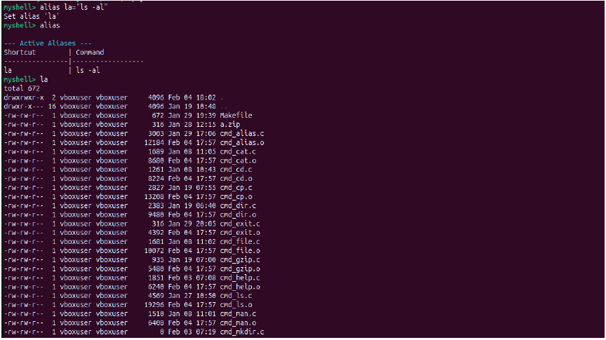


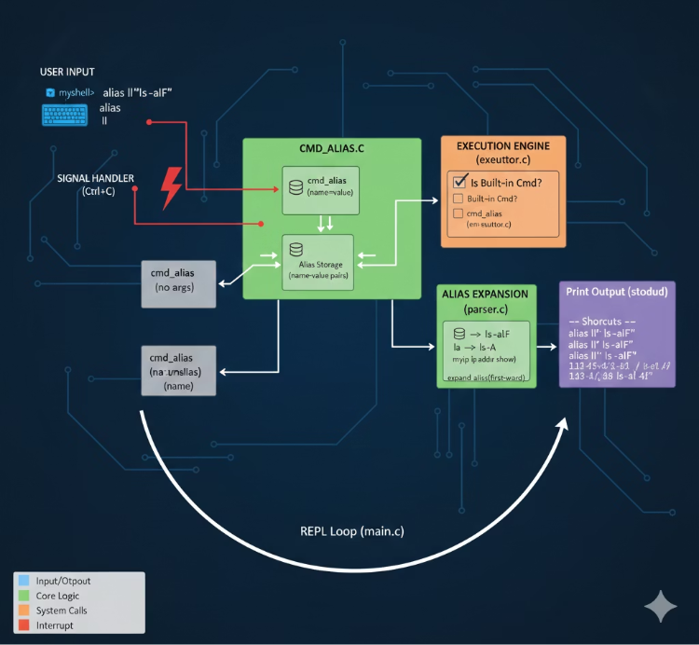

Command Optimization: Alias & Unalias Management
Our shell features a robust Alias Management System (cmd_alias.c) designed to streamline
workflows and reduce repetitive typing. It provides powerful tools for creating, managing, and utilizing command shortcuts effectively.
"Aliasing is not just about saving keystrokes; it's about reducing cognitive load and focusing on the task, not the syntax."
The Tool
A comprehensive, full-featured Alias Management System implemented through cmd_alias.c for ultimate command customization.
Live Creation
Effortlessly map complex command strings to short, memorable keywords (e.g., alias myip="ip addr") in real-time.
On-the-fly Expansion
Seamlessly swap shortcuts for their full command equivalents during the parsing phase, ensuring rapid and accurate execution.
Visibility
Access a clean, formatted table of all active shortcuts via the alias command, providing clear oversight of your personalized environment.

Slide 8

Technical Challenge: Resolving Flag Collision
A critical challenge arose with the watch command, which inadvertently "stole" flags intended for its sub-commands (e.g., -m for free -m). This led to incorrect command interpretation and execution.
Design Prefix
Analyze Impact
Introduce a "+" prefix to indicate sub-command flags.
Validate Fix
The Problem: Ambiguous Flags
Assess misinterpreted commands and failing flows.
Run tests to confirm correct flag routing.
The watch command's flag parsing interfered with the flags of the command it was monitoring, leading to unexpected behavior and errors.
The Solution: The "+" Prefix
Identify Collision
Implement Parsing
We implemented the "+" prefix in getopt(), a subtle yet powerful mechanism to differentiate flags and ensure correct parsing context.
Detect flags consumed by watch instead of subcommands.
Update parser to accept and prioritize + prefixed flags.
The Result: 100% Flag Accuracy
This solution forces the shell to halt parsing watch flags as soon as it identifies the target command, guaranteeing that sub-command flags are correctly processed and interpreted.
The diagram above illustrates how the "+" prefix in getopt() effectively delineates flag ownership, preventing collision and ensuring the integrity of command execution.

Slide 9
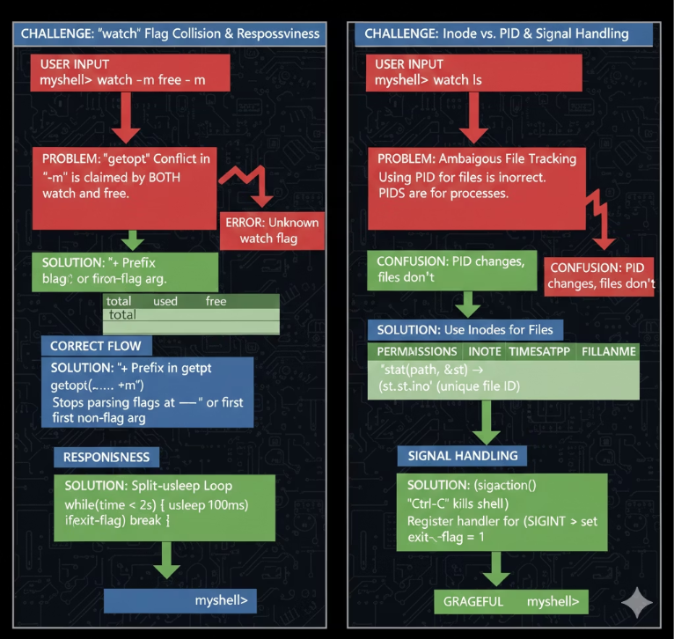

Technical Challenge: Enhanced Signal Responsiveness
Traditional blocking calls like sleep() can render a shell unresponsive to critical signals like Ctrl+C, creating a frustrating user experience. We engineered a solution to ensure instant responsiveness.
The Problem: Laggy Interrupts
Standard sleep() blocks the shell entirely, making Ctrl+C interruptions feel slow and unresponsive during long operations.
The Solution: Split-usleep Loop
We developed a custom Split-usleep Loop, a non-blocking alternative to traditional sleep mechanisms, to maintain immediate signal awareness.
Mechanism: Frequent Checks
Instead of a single sleep(2), we use twenty usleep(100000) calls, each checking the keep_running signal flag every 100ms.
The Result: Instant Responsiveness
This refined approach ensures instant shell responsiveness, even when executing long-running monitoring tasks, drastically improving user interaction and control.

Slide 10
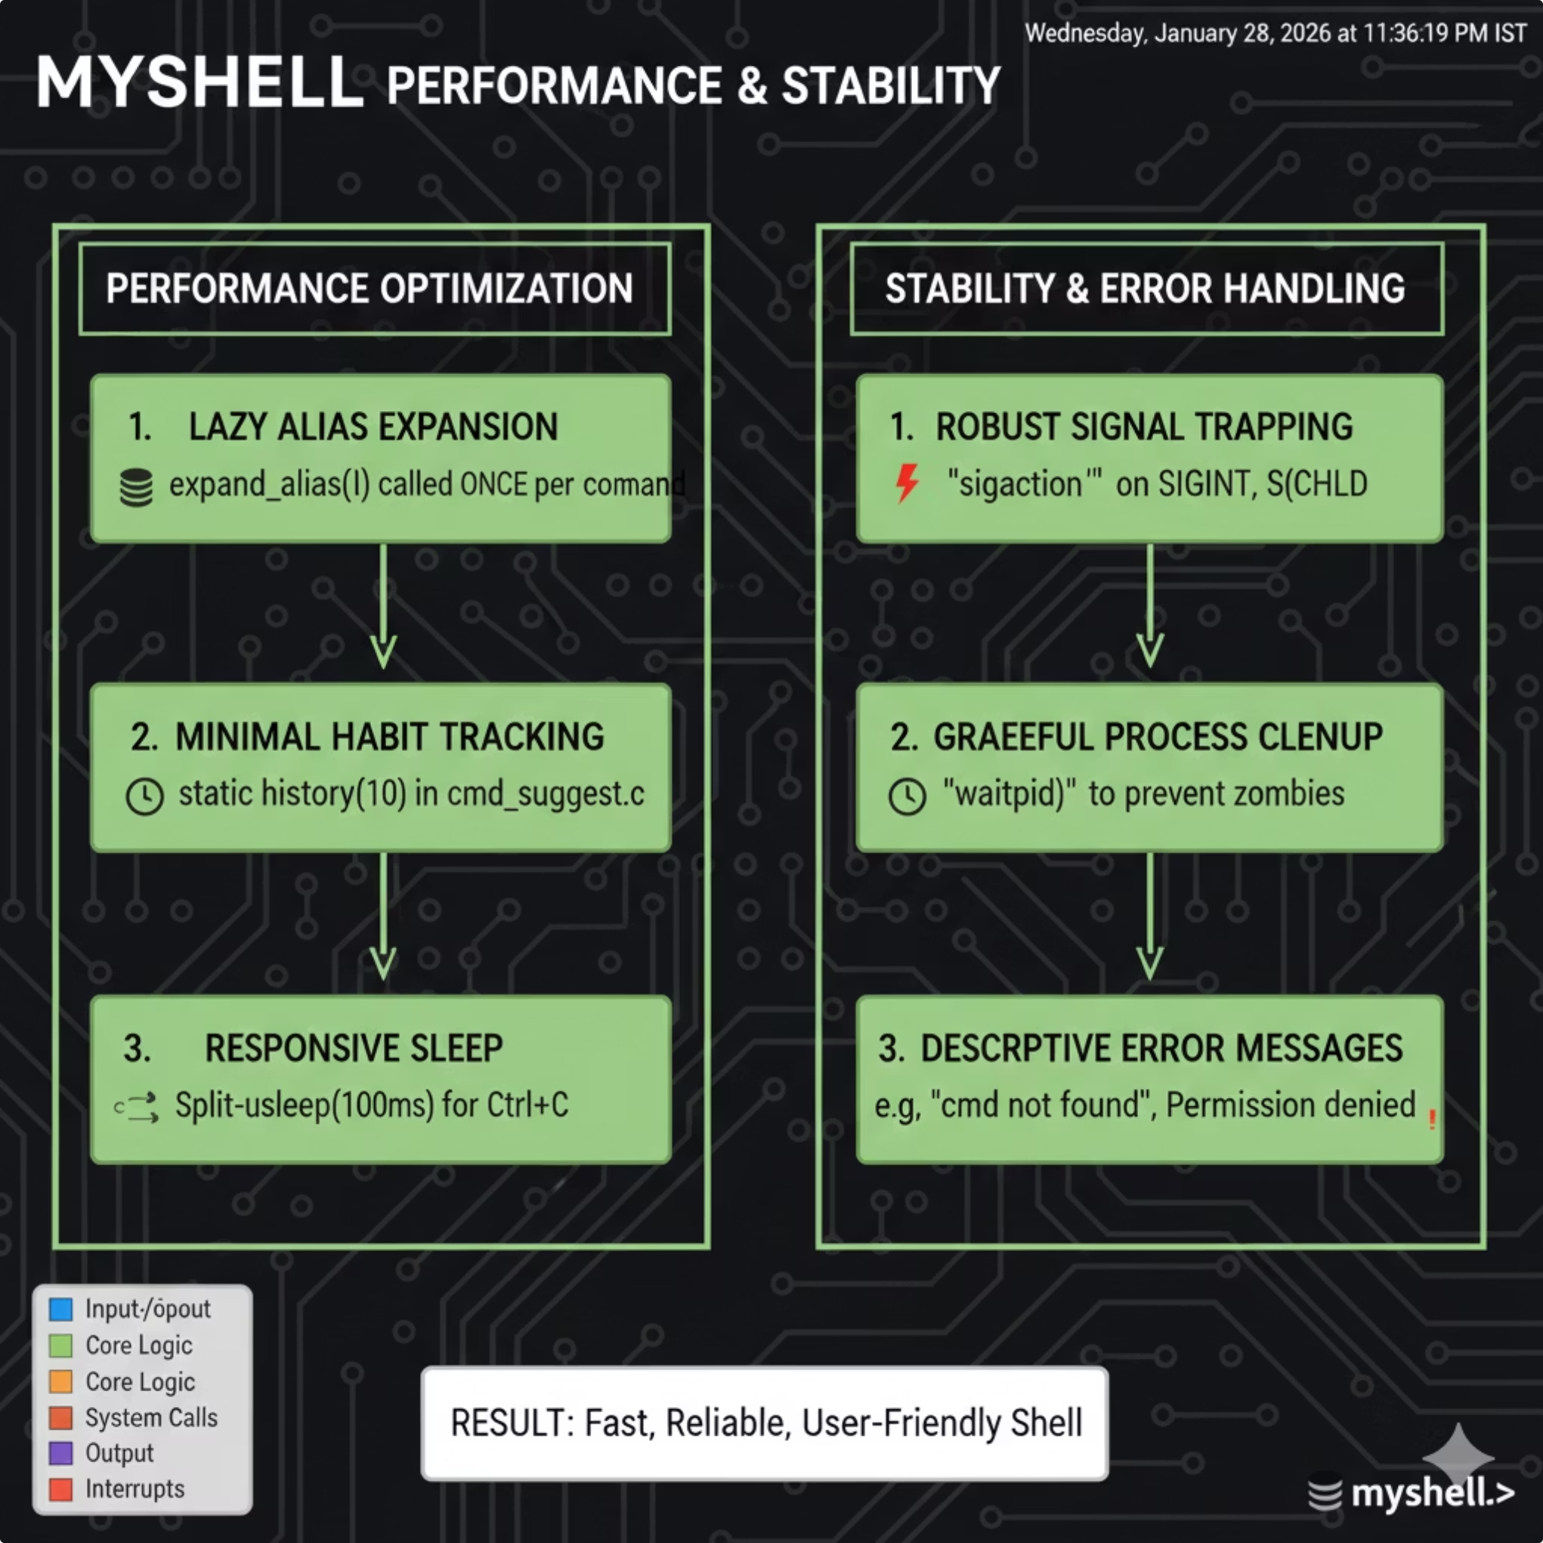

Performance & Stability: Engineered for Reliability
Our shell is built from the ground up with a focus on performance and stability, ensuring a reliable and resource-efficient user experience. We prioritize robust error handling and graceful recovery from unexpected events.
Memory Management
Error Handling
We maintain a minimal memory footprint through diligent static allocation for habit tracking, effectively preventing memory leaks and optimizing resource utilization.
The shell provides clear and informative feedback for common issues like "Command Not Found" and "Permission Denied," guiding users to resolve problems quickly.
Resiliency
Engineered for stability, the shell guarantees a stable recovery to the prompt after sub-process failures or interruptions, minimizing disruption to the workflow.

Slide 11
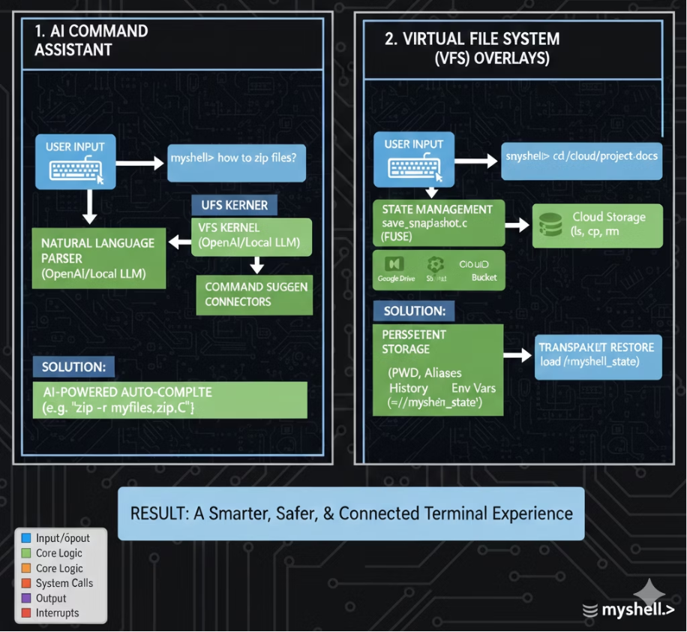




Future Scope: The Path to a Pro-Grade Interface
Our vision extends beyond the current capabilities, aiming to evolve the shell into a truly professional-grade interface with advanced features that anticipate and adapt to user needs, further enhancing productivity and security.
AI Auto-Completion
Integrating local LLM bridges for natural language command suggestions, enabling more intuitive and powerful interaction.
Virtual File System (VFS)
Developing overlays to seamlessly browse cloud storage (e.g., S3/Drive) as if they were local directories, unifying data access.
State Persistence (Snapshots)
Implementing a "Hibernate" feature to save the current PWD, environmental variables, and aliases across reboots, preserving your session context.
Security Auditing
Introducing a real-time "Security Sentinel" to proactively warn against the execution of high-risk commands, bolstering operational security.

Slide 12

Thank you
Our shell doesn't just run commands;
it understands the user's workflow

